Slide 1


K.RAMAKRISHNAN COLLEGE OF ENGINEERING (AUTONOMOUS) SAMAYAPURAM, TRICHY – 621 112.
Final Year Project
April - 2023
Supervisor Name
Mr.P.KASTHURI RENGAN ASST. PROFESSOR/CSE K Ramakrishnan College of
Engineering
Presented By
MARIA MANOJE B (811519104302)
TAMILARASAN V (811519104110)
MOHAMED YUSUF A (811519104070)
VISHWA S (811519104120)

Slide 2

IOT BAESD MILITARY HEALTH SERVICE
IN BATTLE FIELD AND GPS TRACKING

Slide 3
OBJECTIVES
An Internet of Thing (IoT) based health monitoring and tracking system for soldiers in the Battle field.
The device was mounted on the soldier jacket to track their health status and current location using GPS. Thermal jacket which gives better protection to them who are working in extreme weather conditions.
These information will be transmitted to the control room through IoT and also checks the health status including body temperature and heartbeats of soldier.
The System also consists extra feature with the help of that soldier can ask for help manually or send a distress signal to military if he is in need.

Slide 4
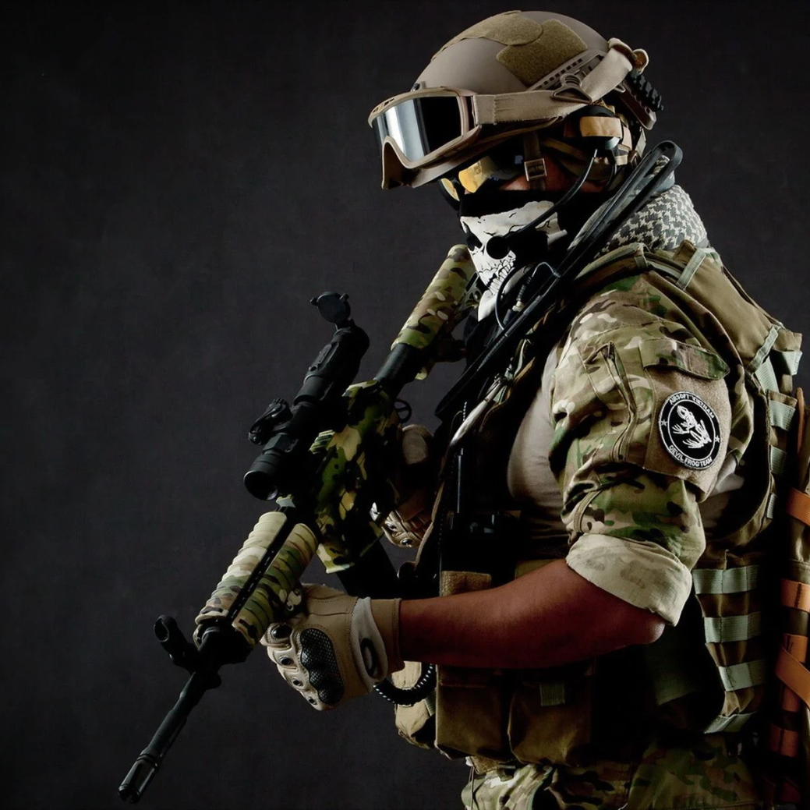
INTRODUCTION
An efficient system which has an application of tracking the soldier’s location and health parameters during the war, which also invokes the military or army officers to plan the war strategies.
Base station gets location of soldier from GPS and communication takes place through the IoT modules.
The base station can access the current status of the soldier which is displayed on the PC and this system uses The IoT.
Using various biomedical sensor health parameters of soldier’s are observed, the position and orientation of soldier is trapped using GPS.

Slide 5
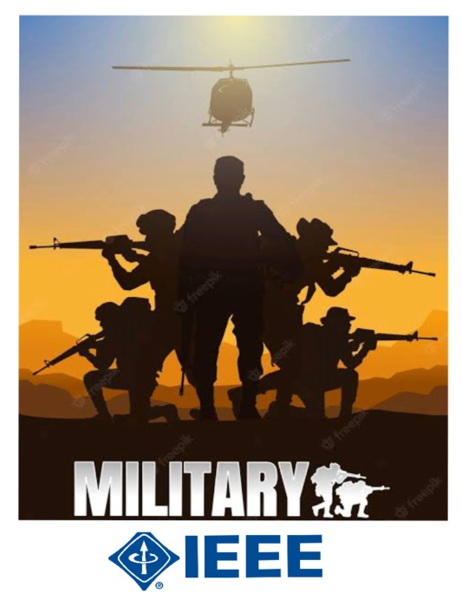
BASE PAPER
BASE PAPER TITLE :
Fully Integrated Wireless Elastic Wearable Systems for Health Monitoring Applications
JOURNAL NAME
IEEE TRANSACTIONS ON COMPONENTS, PACKAGING AND MANUFACTURING TECHNOLOGY
请替换文字内容
AUTHOR NAME
Mohammad H. Behfar , Donato Di Vito , Arttu Korhonen , Dung Nguyen , Belal Mostafa Amin, Timo Kurkela , Markus Tuomikoski, and Matti Mäntysalo. YEAR – (2021).

Slide 6
LITERATURE REVIEW
S.No | Author Name, Paper Title, Journal Name, Year | Technique Used | Merits | Demerits
1. | G. Santhanamari HEALTH MONITORING OF SOLDIERS USING EFFICIENT MANET PROTOCOL IEEE-2020. | Electro Cardio Gram (ECG) over a Mobile Ad hoc Network (MANET) | bio-sensors attached to soldiers’ body and the data is transmitted to the control room | No sharing the live location.
2. | K Keerthana, R Yamini , N Dhesigan Smart Lifeguarding Vest for Military Purpose ,(2020). | bulletproof jacket worn by Indian Army is contrived of Kelvar | Low cost , Life saving. | Didn’t monitoring the health parameter.
3. | Nikhil B. Gaikwad, Hrishikesh Ugale, The Internet of Battlefield Things (IoBT) based Enemy Localization using Soldiers Location and Gunshot Direction,(2020). | soldier’s own locations and their gunshot direction. | Multiple soldiers and multiple enemy scenarios | No sharing there health
4. | JAMES JIN KANG 1 , WENCHENG YANG, No Soldiers Left Behind: An IoT-Based Low-Power Military Mobile Health System Design, IEEE Access(2020). | Low Power Wide Area Networks (LPWAN) and Wireless Body Area Networks (WBAN) | health monitoring as well as user location | Not efficient.
PPT模板下载：www.homeppt.com/moban/ 行业PPT模板：www.homeppt.com/hangye/
节日PPT模板：www.homeppt.com/jieri/ PPT素材下载：www.homeppt.com/sucai/
PPT背景图片：www.homeppt.com/beijing/ PPT图表下载：www.homeppt.com/tubiao/
优秀PPT下载：www.homeppt.com/xiazai/ PPT教程： www.homeppt.com/powerpoint/
Word教程： www.homeppt.com/word/ Excel教程：www.homeppt.com/excel/
资料下载：www.homeppt.com/ziliao/ PPT课件下载：www.homeppt.com/kejian/
范文下载：www.homeppt.com/fanwen/ 试卷下载：www.homeppt.com/shiti/
教案下载：www.homeppt.com/jiaoan/ PPT论坛：www.homeppt.cn
现代战争军事部队
MODERN MILITARY WAR
精美实用/框架完美/战斗/战争汇报

Slide 7
ISSUES IN EXISTING SYSTEM
The system will collect sensitive health data from soldiers, which must be stored securely and in compliance with data privacy regulations.
Data privacy and security
Battery life
The system should have a long battery life to enable continuous monitoring, reducing the need for frequent recharging.
Accuracy and reliability
The system must provide accurate and reliable data to ensure medical personnel can make informed decisions based on the readings.

Slide 8
PROBLEM
STATEMENT
The objective of this system is to provide early warning of potential health issues that could affect the performance of soldiers and to enable medical interventions to be deployed quickly if necessary.
Overall, the soldier health monitoring system should improve the health and well-being of soldiers by providing early detection and intervention of potential health issues, ultimately enhancing the effectiveness and readiness of military personnel.
05
02
The system should be able to transmit data in real-time to a central database or monitoring center where medical personnel can review the readings and take appropriate action if necessary.
03
04
The data collected should be stored securely and be compliant with relevant privacy and data protection regulations.
The soldier health monitoring problem involves developing a system that can continuously monitor the health of soldiers in real-time during military operations.
01

Slide 9
PROPOSED SYSTEM
This project's objective is to develop a soldier monitoring system. It consists of two unit’s “ Solider Unit ” and “ Server Unit ”.
We are using a PIC programmable IC (PIC 16F877A). The wireless technology (IoT) is used in our project for the communication.
A microcontroller board with open source software built on the programmable IC (PIC 16F877A) microcontroller and developed by IoT module.
Military
service
Soldier Unit Server Unit

Slide 10
SOLIDER UNIT
Heart beat sensor and temperature sensor are attached with the soldier unit, to check if the soldier is alive or dead, and sends the information to the server unit.
SERVICE
GPS is interfaced with the Solider Unit (moving unit) which sends the current location of the soldier in the battle field, to the server unit via IoT module.
MILITARY
In any emergency situation soldier can contact the server by giving a request through keypad interfaced with the unit. To prevent inactive the body part for examples finger, heart, leg& hand due to heavy snow.
Thermoelectric cooling uses the peltier effect to create a heat flux between the junctions of two different types of materials which is wearied by soldier for worm up.

Slide 11
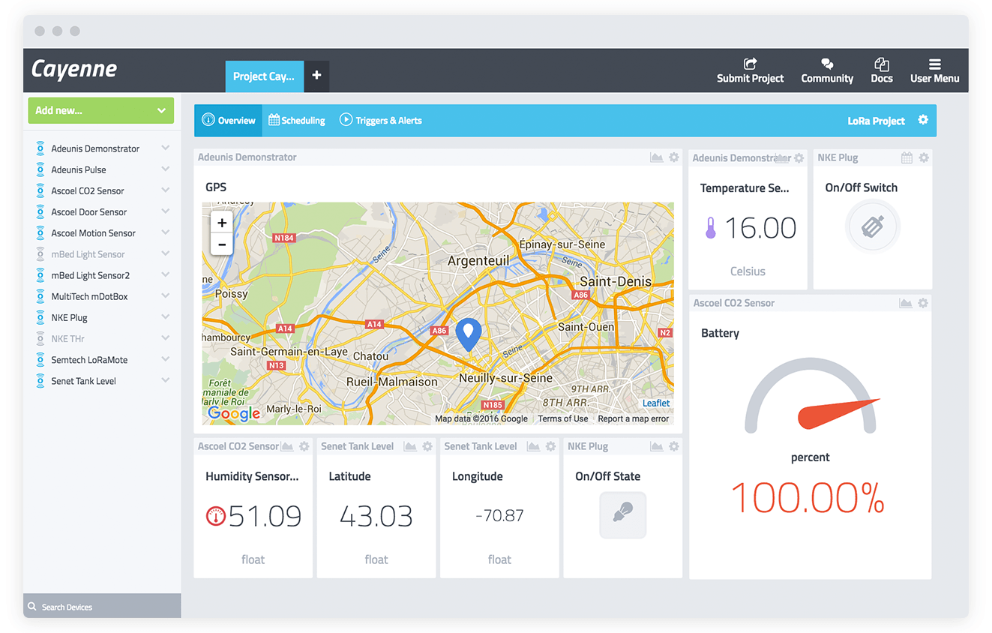
SERVER UNIT
The receiver in the server unit receives the signal and data to monitor and tracks soldier current location.
Server Unit is monitored through PC (Personal Computer) or Mobile and the status is displayed on an LCD screen.
The software running on a PC or mobile to monitors the
status of the Server Unit, and the relevant information is
exhibited on an LCD display.

Slide 12
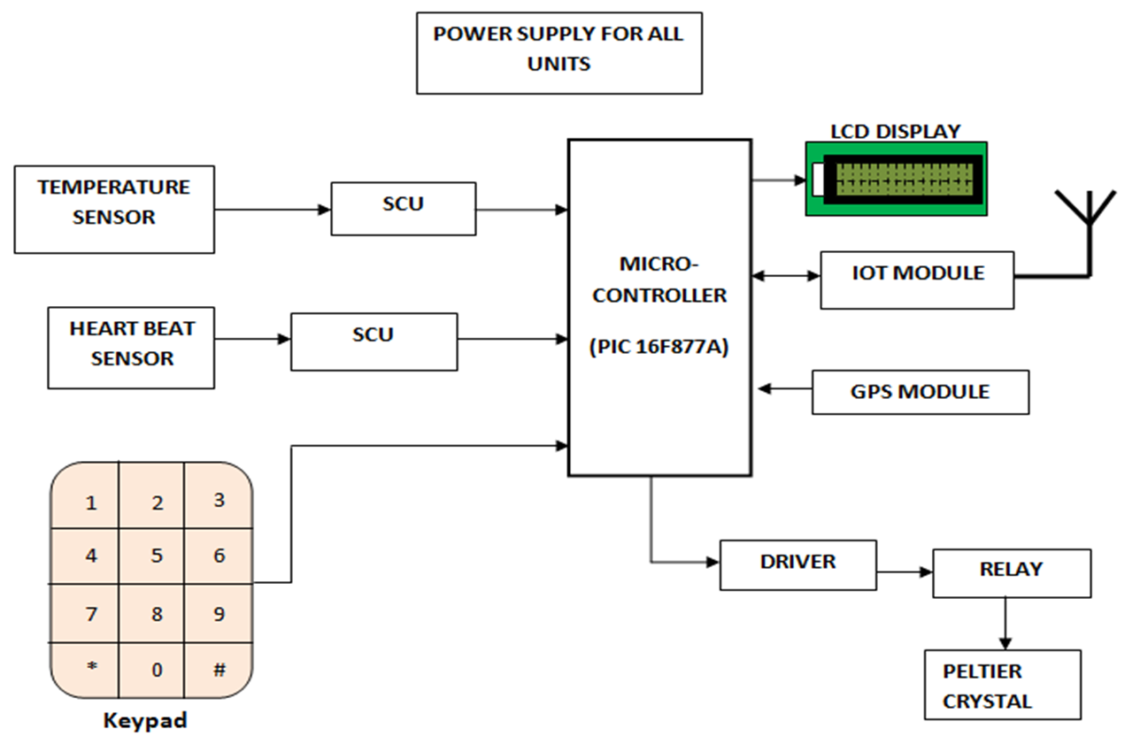
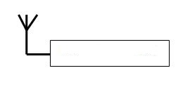
SYSTEM ARCHITECTURE
PC or Mobile phone

Slide 13
MODULES
Heartbeat sensor
Temperature sensor
Peltier Crystal
Matrix Keypad
IoT and GPS module

Slide 14
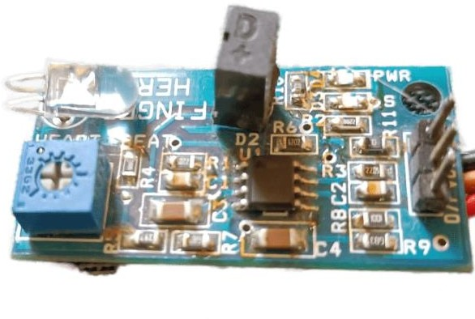
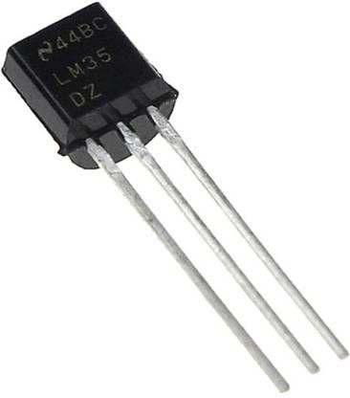
MODULES 1&2
Temperature and Heartbeat sensor :
This module is designed to measure the surface of the body temperature. Temperature sensor (LM35) are attached with the soldier unit, to check the soldier’s body temperature and sends the information to the server unit.
This module is designed to track and check the soldier heart rate. Heart beat sensor and temperature sensor are attached with the soldier unit, to check if the soldier is alive or dead. Heartbeat sensor that gauges heart rate by observing blood flow. They interface with PIC microcontroller.
LM 35 sensor Heart beat sensor

Slide 15
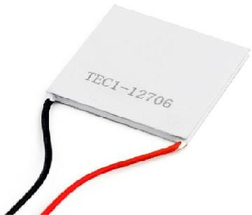
MODULES 3
Peltier Crystal :
This module is designed for produce heat and cooling based on soldier different body temperature. Thermoelectric cooling uses the Peltier effect to create a heat flux between the junctions of two different types of materials. A Peltier crystal is a solid-state active component which transfers heat or cooling from one side to other side.
Soldier body temperature exceeds the threshold value of 40 degree, the cooling system will be activated. Similarly, if the temperature drops below the threshold value of 28 degrees, the heating system will be activated.
Peltier crystal

Slide 16
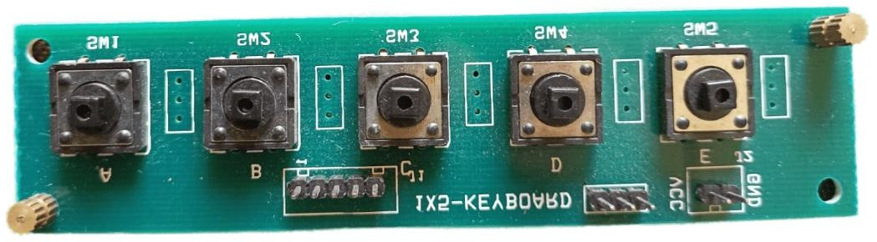
MODULES 4
Matrix Keypad :
This module is designed for soldier can be use the keypad linked to the device to hit a button to call the server in case of an emergency. To avoid bodily parts becoming inactive such as leg, hand, fingers and others because of a lot of snow. They interfacing with PIC microcontroller.
This keypad provides a visually appealing way to get numeric data to your control system. The board is a series of pushbutton switches that provide structured input for measuring user input.
Matrix keypad

Slide 17
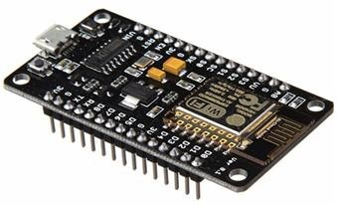
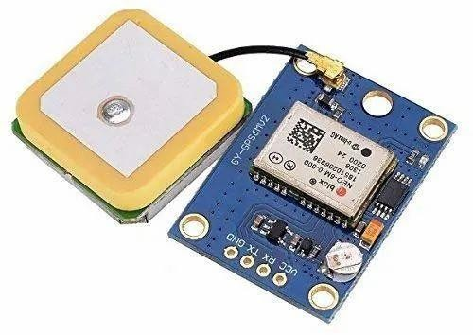
MODULES 5&6
IoT and GPS module :
IoT module is used to transmitting the data to server unit or base station via Internet. The IoT module establishes a strong connection between the Internet world and the physical world.
GPS module is designed to track the soldier exact location. To locate soldiers, the system incorporates GPS technology, which provides precise location information. The GPS modem is utilized to receive signals from satellites and determine the soldier's latitude and longitude, which are subsequently transmitted through serial data to the controller.
GPS module IoT module

Slide 18
ADVANTAGES
1
Thermal jacket which gives better protection to them who are working in extreme weather conditions. It’s cost effective.
2
The health conditions of the soldier can be closely monitored from the remote location. Using a heart rate monitor is an ideal method of assessing one's cardiovascular condition.
3
Keypad linked to the device to hit a button to call the server in case of an emergency. So, soldier no need to go base station.
4
The use of the GPS provides the location from any part of the world. It’s fast and efficient.

Slide 19
FUTURE
SCOPE
In the future we can add the gas detective sensors. So that it can detect the gases which are harmful for the human beings in forest area specially.
In the future, it is possible to enhance the system by incorporating a solar collector that can recharge the power source automatically when the device is exposed to sunlight.
The system may be altered to better serve patients, and a camera that records video can be utilized to remotely monitor their activities while also providing information such as the time, date, latitude and longitude as well as the speed and direction of movement.

Slide 20
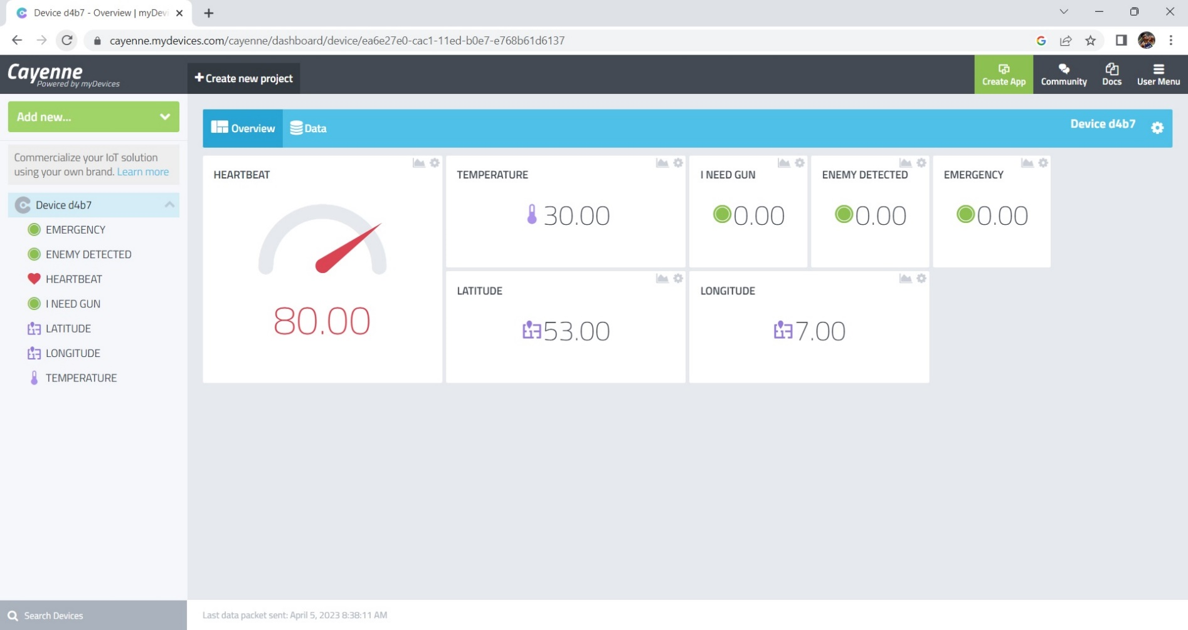
HEART BEAT

Slide 21
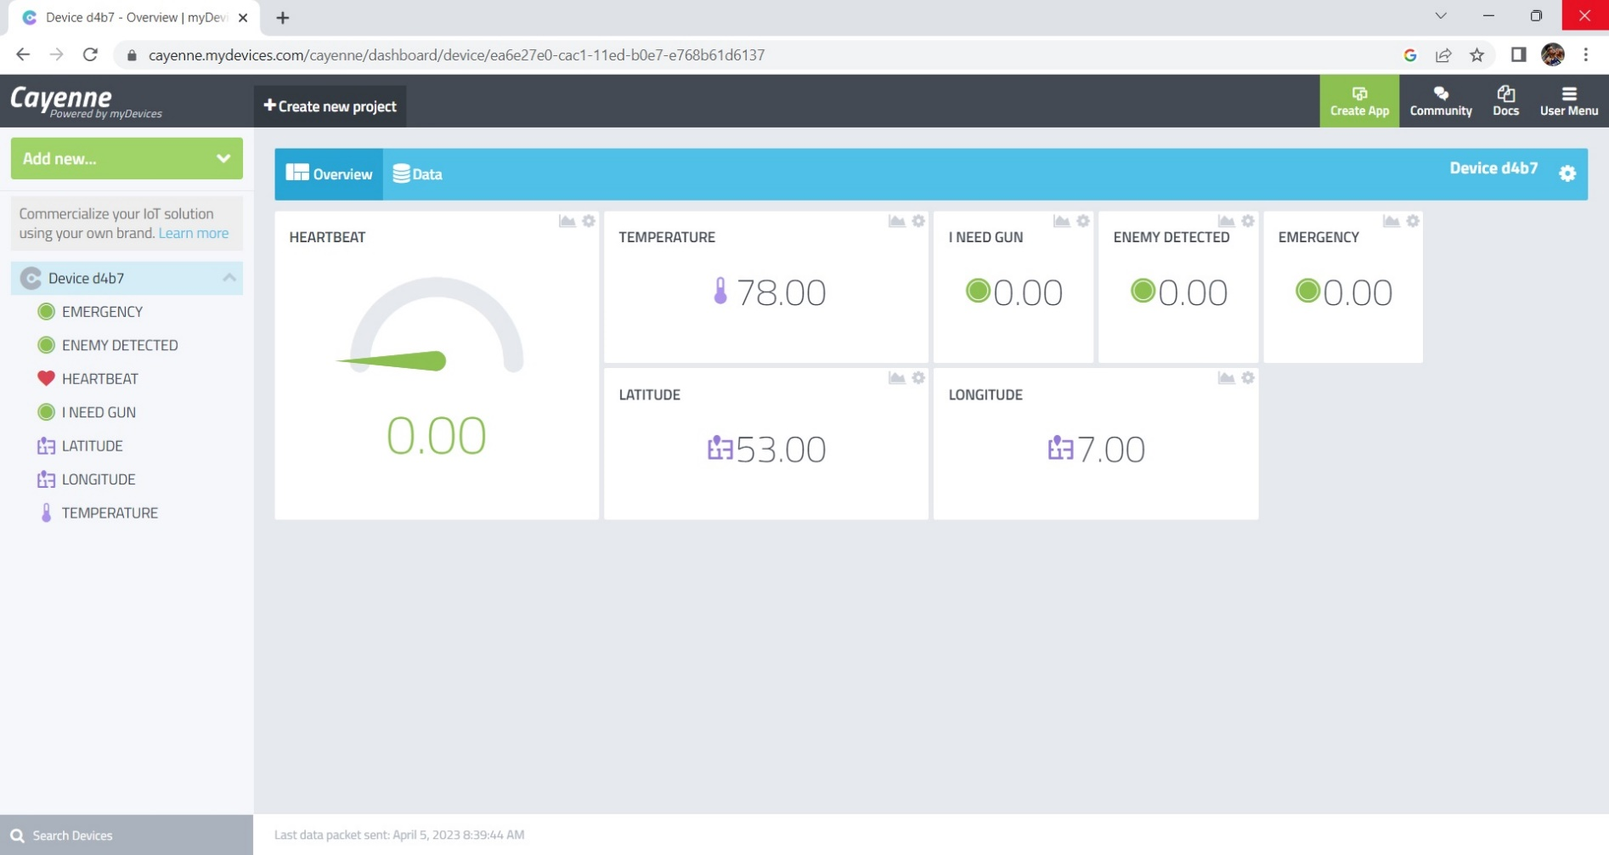
TEMPERATURE

Slide 22
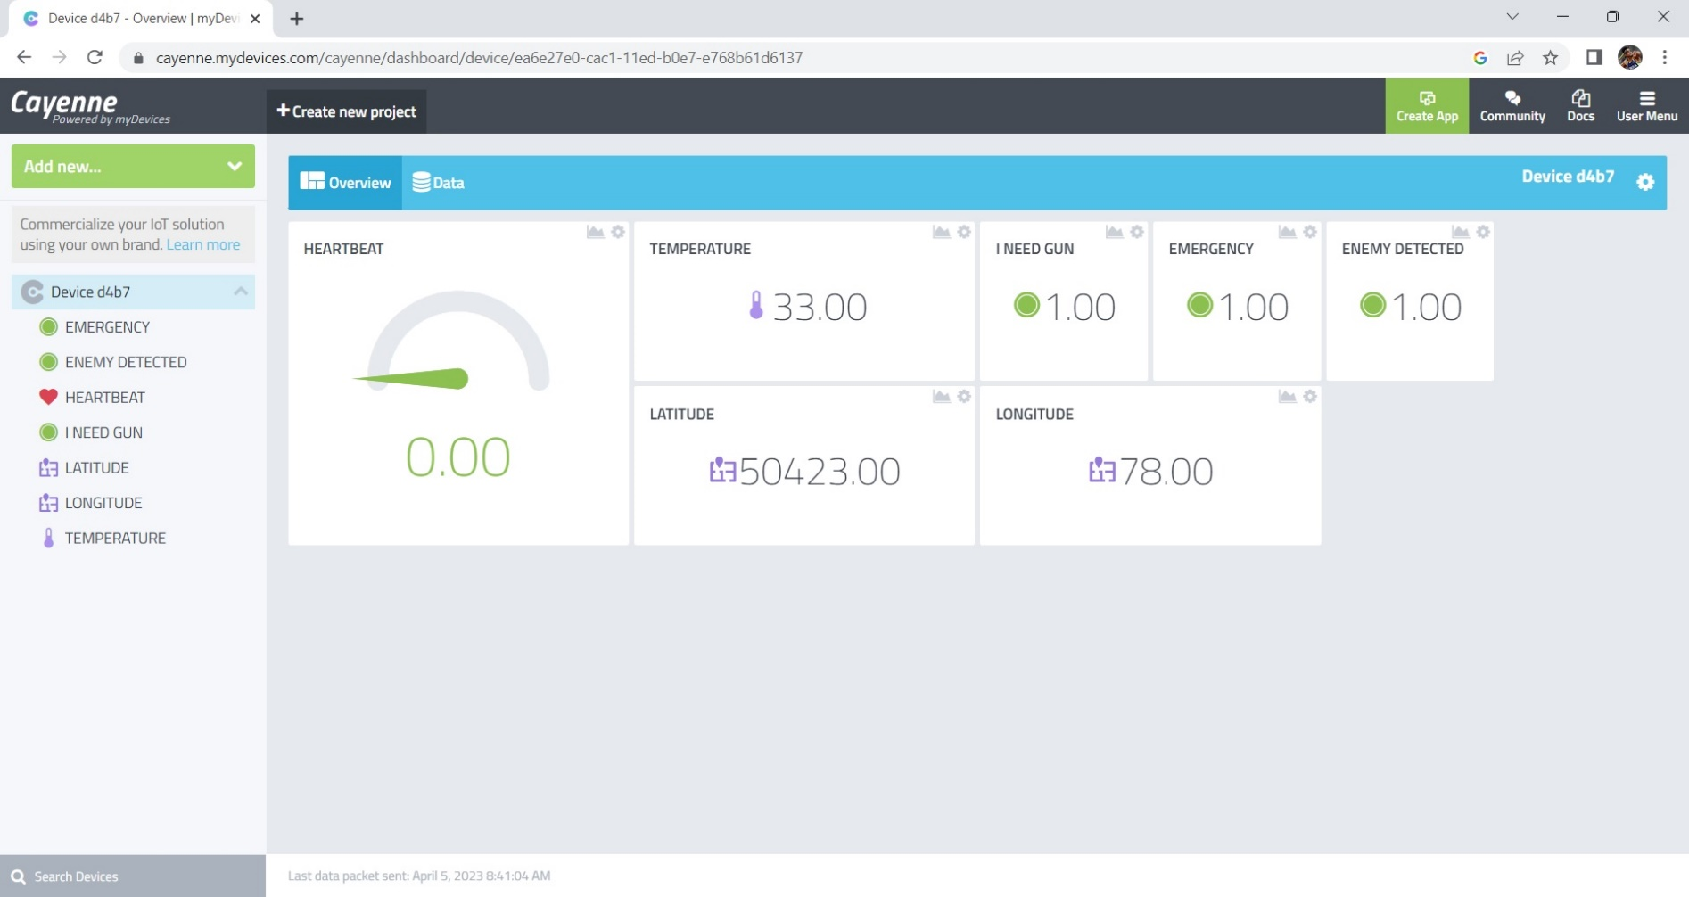
MATRIX KEYPAD

Slide 23

GPS

Slide 24
CONCLUSION
Biomedical sensors can provide heartbeat and body temperature of every soldier to the control room. This technology can be helpful to provide the accurate location of missing soldier in critical condition and overcome the drawback of soldiers missing in action. The addressing system is also helpful to improve the communication between soldier to soldier in emergency situation and provide the proper navigation to control room.

Slide 25
PAPER PRESENTED IN CONFERENCE
Conference Detail:
2 nd International Conference on Sustainable Computing and Data Communication Systems(ICSCDS-20)
Paper Title:
IOT BAESD MILITARY HEALTH SERVICE IN BATTLE FIELD AND GPS TRACKING
College name :
Shree Venkateshwara Hi-Tech Engineering College Erode, India. Date: 23/03/2023

Slide 26
REFERENCES
Mohammad H. Behfar , Donato Di Vito , Arttu Korhonen , Dung Nguyen , Belal Mostafa Amin, Timo Kurkela , Markus Tuomikoski, and Matti Mäntysalo, Fully Integrated Wireless Elastic Wearable Systems for Health Monitoring Applications Year – (2021).
01
Jasvinder Singh, Akshay Chahajed, Samle Pandit, Suchith Weigh, “GPSand IOT Based Soldier Tracking and Health Indication System”, International Research Journal of Engineering and Technology, pp. 2395-0056, 2019.
02
Brijesh Iyer, Nkit Patil, “IoT Enabled Tracking and Monitoring Sensor for Military Applications”, International Conference on Computing, Communication and Automation (ICCCA), vol. 9, no. 2 pp. 2319-7242, 2018.
03
William Walker, A L Praveen Aroul, Dinesh Bhatia, “Mobile Health Monitoring Systems”, 31st Annual International Conference of the IEEEEMBS, Minneapolis, Minnesota, USA, pp. 5199-5202,2018
04

Slide 27
THANK YOU

